Slide 1

Genome-Wide Association Studies
Caitlin Collins, Thibaut Jombart
MRC Centre for Outbreak Analysis and Modelling
Imperial College London
Genetic data analysis using
30-10-2014

Slide 2
Outline
Introduction to GWAS
Study design
GWAS design
Issues and considerations in GWAS
Testing for association
Univariate methods
Multivariate methods
Penalized regression methods
Factorial methods

Slide 3
Genomics & GWAS

Slide 4

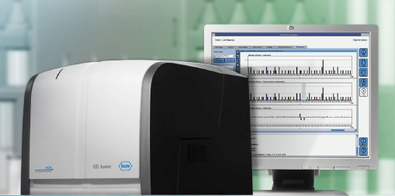
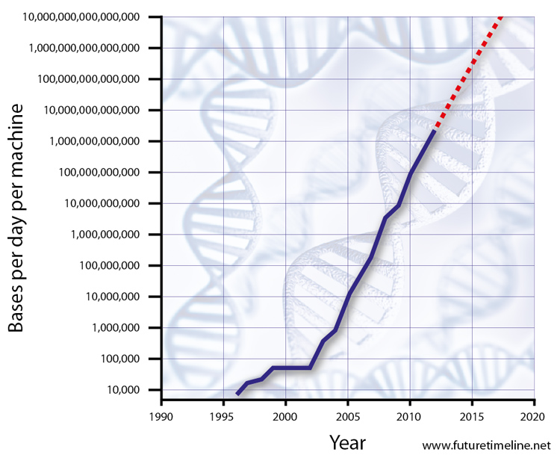
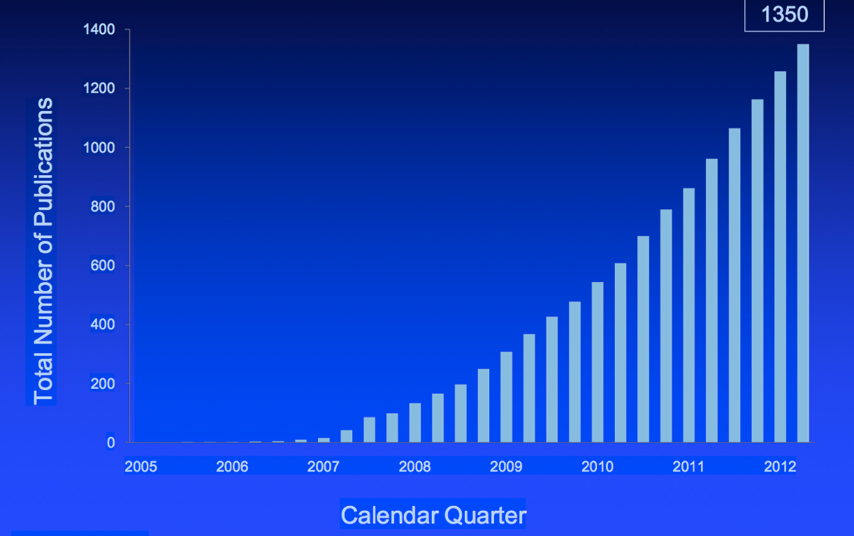
The genomics revolution
Sequencing technology
1977 – Sanger
1995 – 1st bacterial genomes
< 10,000
bases per day per machine
2003 – 1st human genome
> 10,000,000,000,000
bases per day per machine
GWAS publications
2005 – 1st GWAS
Age-related macular degeneration
2014 – 1,991 publications
14,342 associations

Slide 5
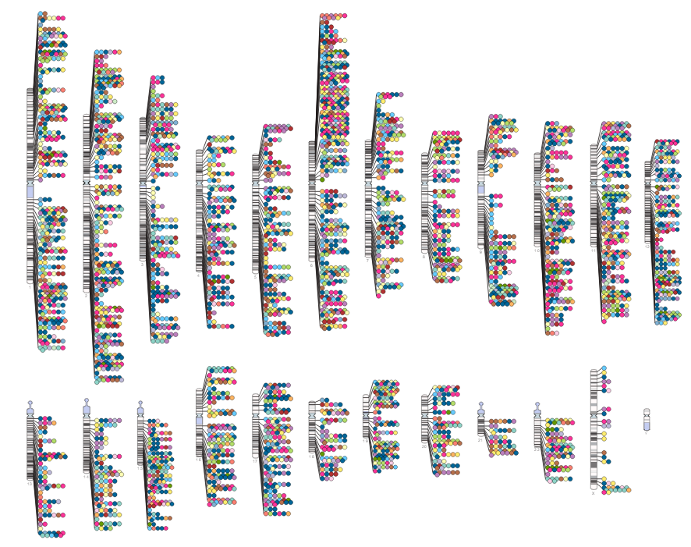
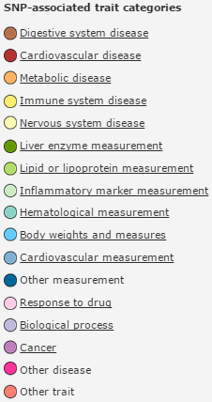
A few GWAS discoveries…

Slide 6

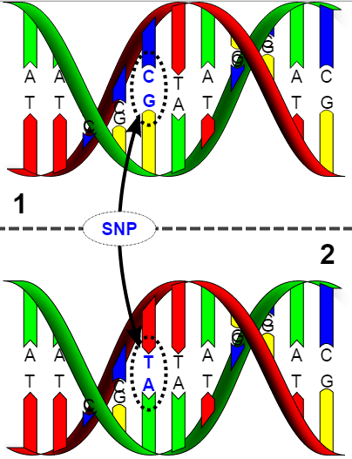
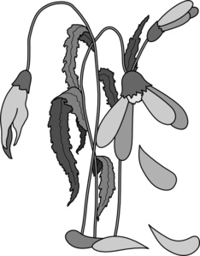
So what is GWAS?
Genome Wide Association Study
Looking for SNPs…
associated with a phenotype.
Purpose:
Explain
Understanding
Mechanisms
Therapeutics
Predict
Intervention
Prevention
Understanding not required

Slide 7
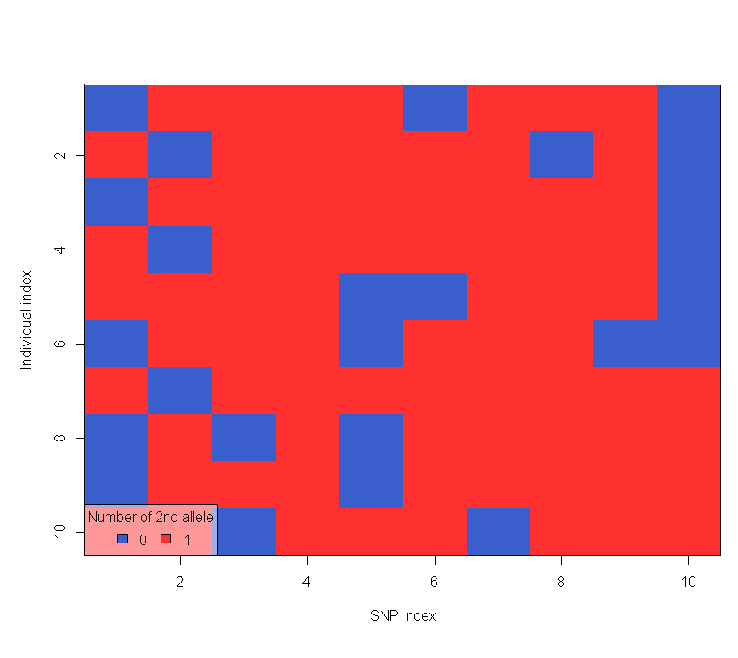






Association
p SNPs
Definition
Any relationship between two measured quantities that renders them statistically dependent.
Heritability
The proportion of variance explained by genetics
P = G + E + G*E
Heritability > 0
Controls
Cases
n individuals

Slide 8


Slide 9
Why?
Environment, Gene-Environment interactions
Complex traits, small effects, rare variants
Gene expression levels
GWAS methodology?

Slide 10
Study Design

Slide 11




GWAS design
Case-Control
Well-defined “case”
Known heritability
Variations
Quantitative phenotypic data
Eg. Height, biomarker concentrations
Explicit models
Eg. Dominant or recessive

Slide 12

Issues & Considerations
Data quality
1% rule
Controlling for confounding
Sex, age, health profile
Correlation with other variables
Population stratification*
Linkage disequilibrium*
*
*

Slide 13
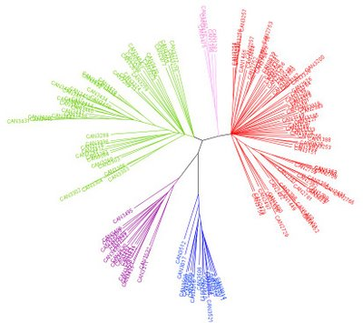
Population stratification
Definition
“Population stratification” = population structure
Systematic difference in allele frequencies btw. sub-populations…
… possibly due to different ancestry
Problem
Violates assumed population homogeneity, independent observations
→ Confounding, spurious associations
Case population more likely to be related than Control population
→ Over-estimation of significance of associations

Slide 14
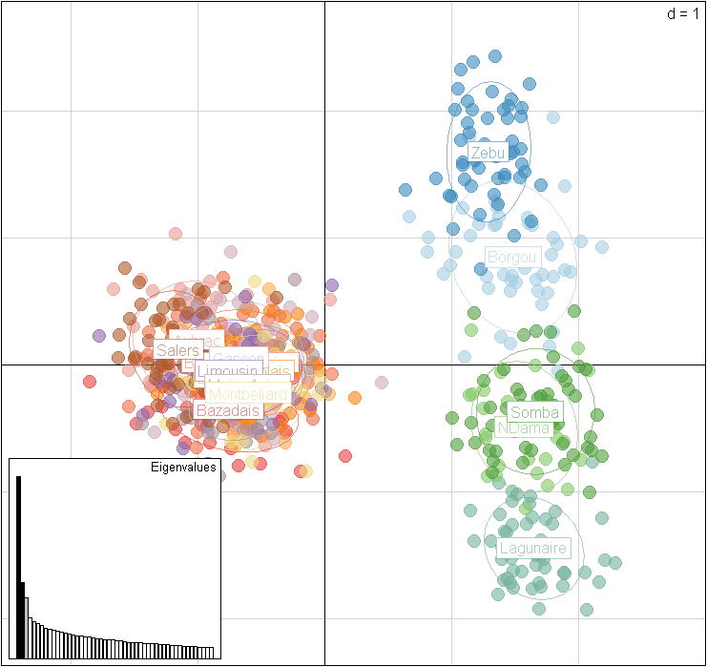
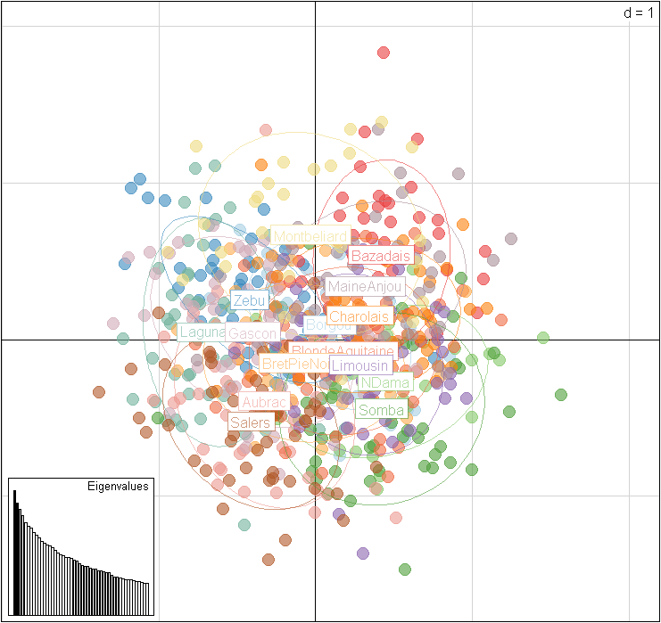
Population stratification II
Solutions
Visualise
Phylogenetics
PCA
Correct
Genomic Control
Regression on Principal Components of PCA

Slide 15
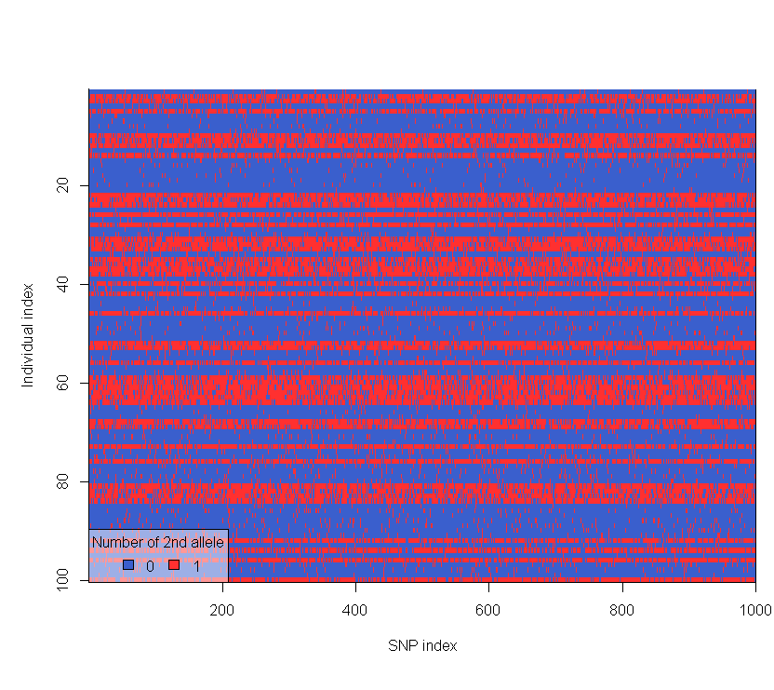
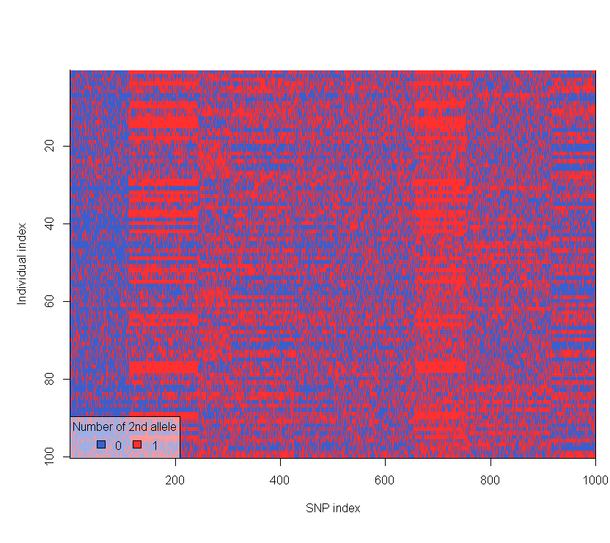
Linkage disequilibrium (LD)
Definition
Alleles at separate loci are NOT independent of each other
Problem?
Too much LD is a problem
→ noise >> signal
Some (predictable) LD can be beneficial
→ enables use of “marker” SNPs

Slide 16
Testing for Association

Slide 17

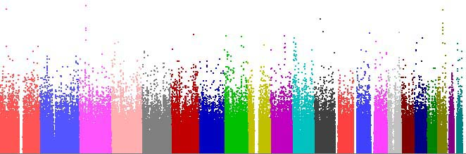
Methods for association testing
Standard GWAS
Univariate methods
Incorporating interactions
Multivariate methods
Penalized regression methods (LASSO)
Factorial methods (DAPC-based FS)

Slide 18
Univariate methods
p SNPs
Approach
Individual test statistics
Correction for multiple testing
Controls
Cases
Variations
Testing
Fisher’s exact test, Cochran-Armitage trend test, Chi-squared test, ANOVA
Gold Standard—Fischer’s exact test
Correcting
Bonferroni
Gold Standard—FDR
n individuals

Slide 19
Univariate – Strengths & weaknesses
Strengths
Weaknesses
Straightforward
Computationally fast
Conservative
Easy to interpret
Multivariate system, univariate framework
Effect size of individual SNPs may be too small
Marginal effects of individual SNPs ≠ combined effects

Slide 20
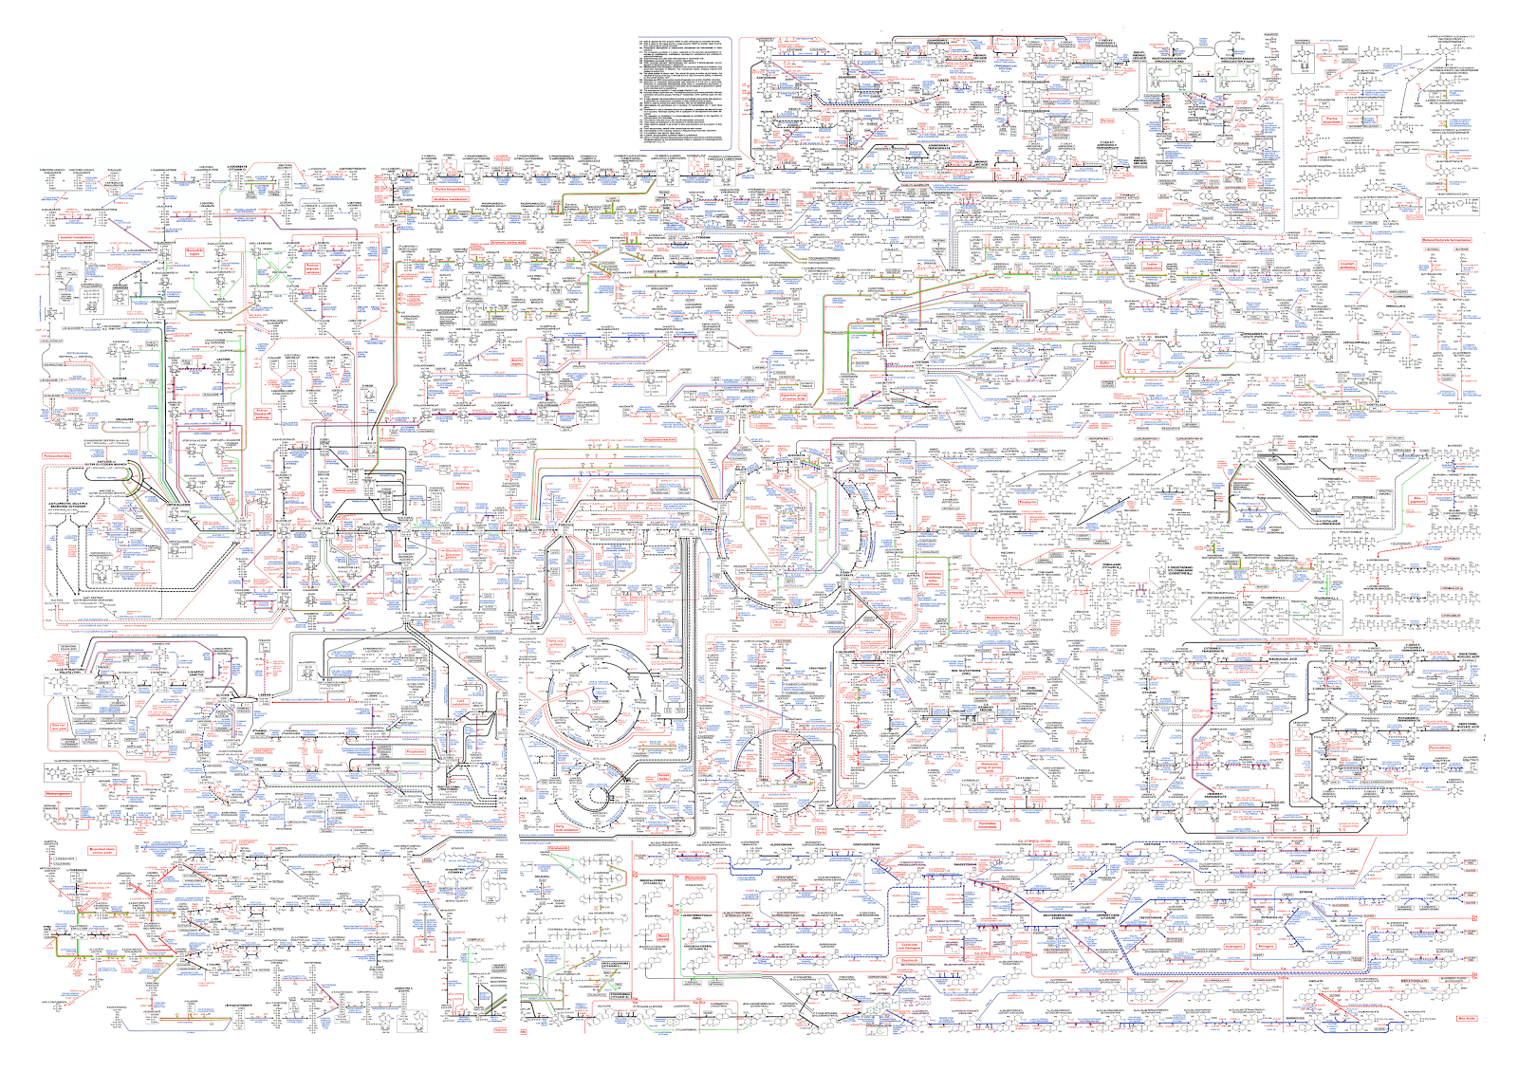
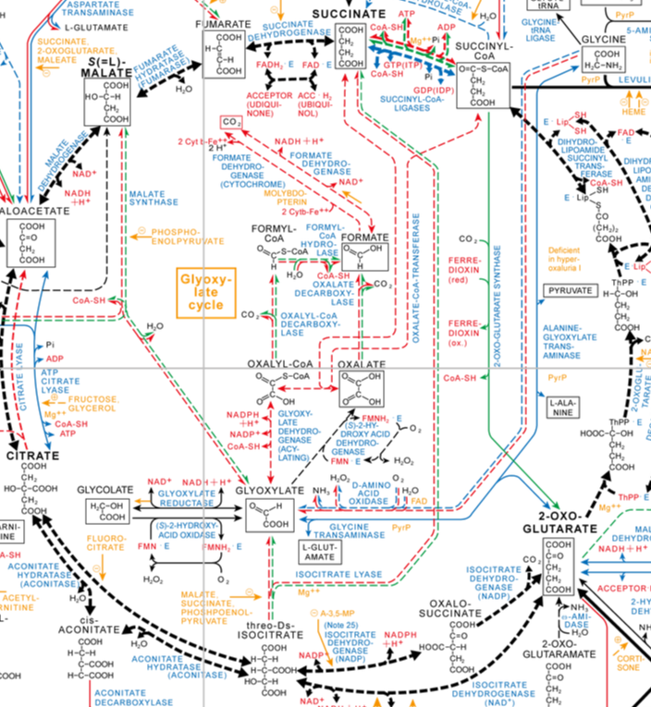
What about interactions?

Slide 21
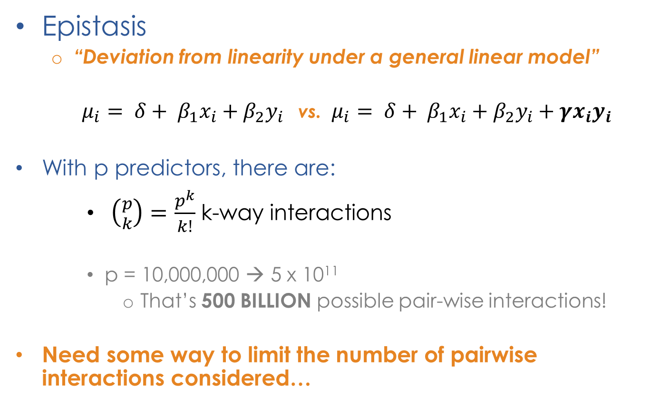
Interactions
Epistasis
“Deviation from linearity under a general linear model”
$μ_{i}= δ+ β_{1}x_{i}+β_{2}y_{i}$ vs. $μ_{i}= δ+ β_{1}x_{i}+β_{2}y_{i}+γx_{i}y_{i}$
With p predictors, there are:
$\left({p \atop k}\right)=\frac{p^{k}}{k!}$ k-way interactions
p = 10,000,000 → 5 x 10¹¹
That’s 500 BILLION possible pair-wise interactions!
Need some way to limit the number of pairwise interactions considered…

Slide 22
Multivariate methods
Neural Networks
Penalized Regression
Genetic programming optimized neural networks
LASSO penalized regression
Parametric
decreasing method
The elastic net
Ridge regression
Logic Trees
Logic feature selection
Monte Carlo
Logic Regression
Bayesian Approaches
Logic regression
Bayesian partitioning
Modified Logic Regression-Gene Expression Programming
Bayesian Logistic Regression with Stochastic Search Variable Selection
Bayesian Epistasis Association Mapping
Genetic Programming for Association Studies
Set association
approach
Factorial Methods
Non-parametric Methods
Sparse-PCA
Multi-factor dimensionality reduction method
Random forests
Restricted
partitioning method
Supervised-PCA
DAPC-based FS (snpzip)
Combinatorial partitioning method
Odds-ratio-
based MDR

Slide 23
Multivariate methods
Penalized regression methods
LASSO penalized regression
Factorial methods
DAPC-based
feature selection

Slide 24
Penalized regression methods
Approach
Regression models multivariate association
Shrinkage estimation → feature selection
Variations
LASSO, Ridge, Elastic net, Logic regression
Gold Standard—LASSO penalized regression

Slide 25
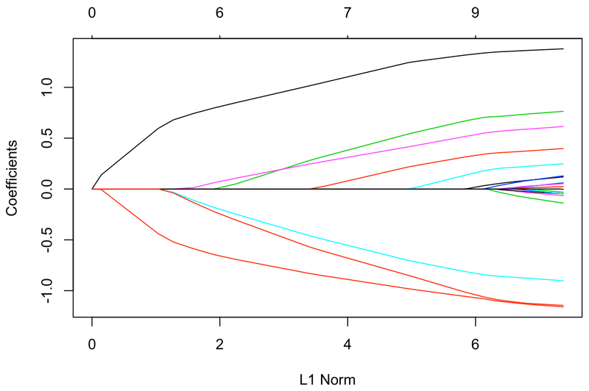
LASSO penalized regression
Regression
Generalized linear model (“glm”)
Penalization
L1 norm
Coefficients → 0
Feature selection!

Slide 26
LASSO – Strengths & weaknesses
Strengths
Weaknesses
Stability
Interpretability
Likely to accurately select the most influential predictors
Sparsity
Multicollinearity
Not designed for high-p
Computationally intensive
Calibration of penalty parameters
User-defined → variability
Sparsity

Slide 27
Factorial methods
Approach
Place all variables (SNPs) in a multivariate space
Identify discriminant axis → best separation
Select variables with the highest contributions to that axis
Variations
Supervised-PCA, Sparse-PCA, DA, DAPC-based FS
Our focus—DAPC with feature selection (snpzip)

Slide 28


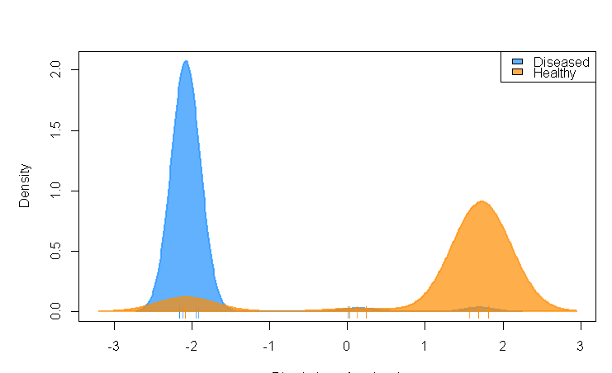
DAPC-based feature selection
a
b
e
d
Alleles
c
Individuals
Diseased (“cases”)
Discriminant Axis
Healthy (“controls”)
Discriminant Axis
Density of individuals
Density of individuals
Discriminant axis
Discriminant axis

Slide 29
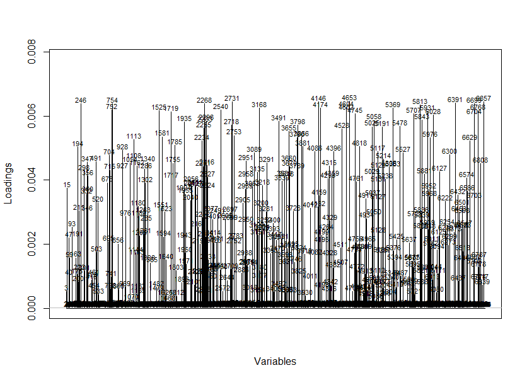
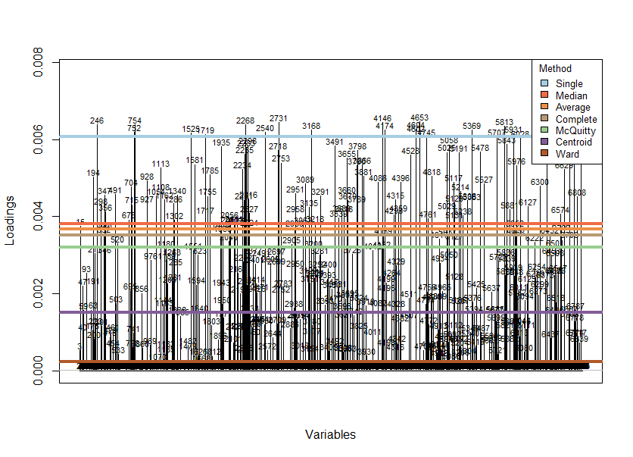
DAPC-based feature selection
Where should we draw the line?
→ Hierarchical clustering
Density of individuals
?
Discriminant axis

Slide 30
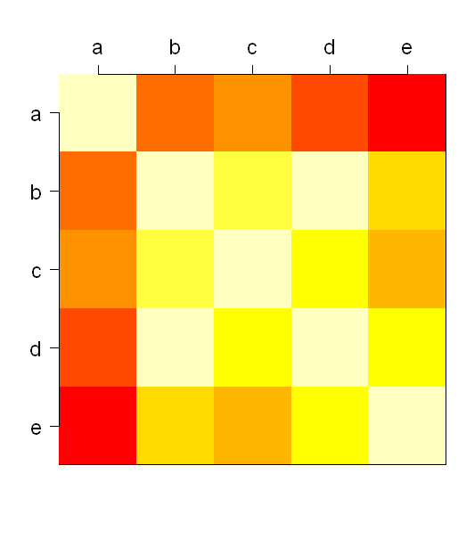
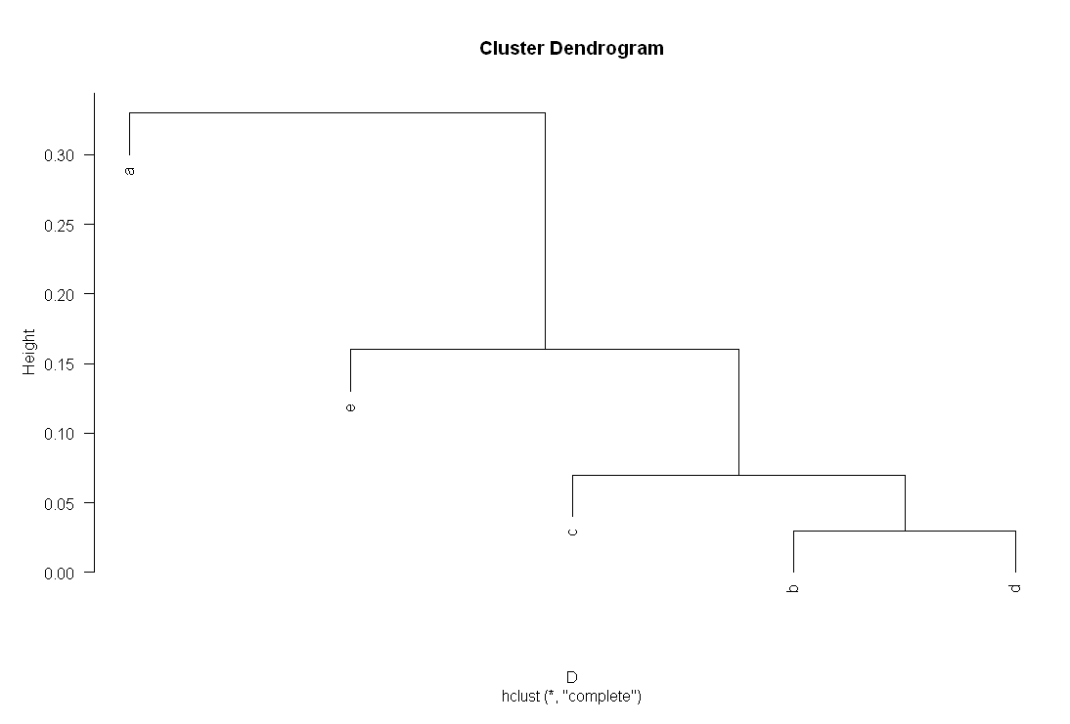
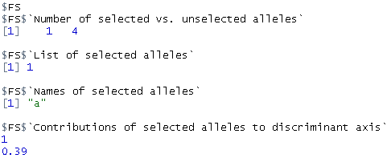

Hierarchical clustering (FS)
Hooray!

Slide 31
DAPC – Strengths & weaknesses
Strengths
Weaknesses
More likely to catch all relevant SNPs (signal)
Computationally quick
Good exploratory tool
Redundancy > sparsity
Sensitive to n.pca
N.snps.selected varies
No “p-value”
Redundancy > sparsity

Slide 32
Conclusions
Study design
GWAS design
Issues and considerations in GWAS
Testing for association
Univariate methods
Multivariate methods
Penalized regression methods
Factorial methods

Slide 33
Thanks for listening!

Slide 34
Questions?

